Slide 1
Agenda
Leadership
Characteristics and Traits
Skills
Leadership vs. Management
Situational Application
Decision Making

Slide 2
Leadership

Slide 3
Leadership
“Leadership is a process whereby an individual influences a group of individuals to achieve a common goal” (Northouse, 2007)
Effective Leadership Empowers Others (Kotter, 1990)
People feel significant
Learning and competence matter
People are part of a community
Work is exciting

Slide 4
Leadership
Characteristics and Traits

Slide 5
Leadership Traits
Traits Found Most Frequently to be Characteristic of Successful Leaders
Intelligence
Self-Confidence
Determination
Integrity
Sociability
Source: Northouse, 2007

Slide 6
Skill Based Model
Leadership outcomes depend on three primary components
Problem Solving Skills
Social Judgement Skills
Knowledge
Rather than an inherent attribute, leadership may be learned
Source: Northouse, 2007

Slide 7
Leadership
Leadership vs. Management

Slide 8
Leadership vs. Management
Management
To manage means to accomplish activities and master routines
Management produces order and consistency
Management is about coping with complexity
Leadership
To lead means to influences others and create visions for change
Leadership produces change and movement
Leadership is about coping with change
Northouse, 2007; Kotter, 1990

Slide 9
What Leaders Really Do?
Tasks associated with Leadership
Deciding what needs to be done
Creating networks of people and relationships that can accomplish an agenda
Executing to ensure people actually do the job
What Leaders Really Do, Kotter, 1990

Slide 10
What Leaders Really Do?
Task | Leadership | Management
Deciding | Developing a vision | Set goals and objectives
Creating | Aligning people through communication | Organizing and staffing
Executing | Motivating and inspiring | Controlling and Problem Solving
What Leaders Really Do, Kotter, 1990

Slide 11
Building Your Company’s Vision
A “Vision” contains two major components
Core Values and Purpose
Envisioned future – 10 – 30 year audacious goal with a vivid description
Core values and vision rarely change
Building Your Company’s Vision, Collins and Porras, 1996
Notes:
Walt Disney
No cynicism
Nurturing and promulgation of wholesome values
Creativity, dreams, and imagination
Fanatical attention to consistency and detail
Preservation and control of the Disney magic

Slide 12
Putting it All Together: Sony in the 1950s
Core Ideology
Core Values
Elevation of the Japanese culture and national status
Being a pioneer – not following others; doing the impossible
Encouraging individual ability and creativity
Core Purpose
To experience the sheer joy of innovation and the application of technology for the benefit and pleasure of the general public.
Envisioned Future
BHAG
Become the company most known for changing the worldwide poor-quality image of Japanese products
Vivid Description
We will create products that become pervasive around the world…We will b the first Japanese company to go into the U.S. market and distribute directly… We will succeed with innovations that U.S. companies have failed at – such as the transistor radio… Fifty years from now, our brand name will be as well known as any in the world
Building Your Company’s Vision, Collins and Porras, 1996

Slide 13
Leadership
Situational Model

Slide 14
Leadership and the Decision Making Process
How and with whom should decisions be made
Depends on the Situation and Desired Outcomes
Considerations Include
Decision quality
Buy-in
Cost of decision making
Time
Development of org competencies
Five Primary Methods
Decide
Consult Individually
Consult Group
Facilitate
Delegate
Leadership and the Decision-Making Process, Vroom 2000

Slide 15
Vroom’s Adaptation of Tannenbaum and Schmidt’s Taxonomy
Decide
You make the decision alone and either announce or “sell” it to the group. You may use your expertise in collecting information that you deem relevant to the problem from the group or others.
Consult Individually
You present the problem to the group members individually, get their suggestions, and then make the decision.
Consult Group
You present the problem to the group members in a meeting, get their suggestions, and them make the decision.
Facilitate
You present the problem to the group in a meeting. You act as facilitator, defining the problem to be solved and the boundaries within which the decision must be made. Your objective is to get concurrence on a decision. Above all, you take care to ensure that your ideas are not given any greater weight than those of others simply because of your position.
Delegate
You permit the group to make the decision within prescribed limits. The group undertakes the identification and diagnosis of the problem, developing alternative procedures for solving it, and deciding on one or more alternative solutions. While you play no direct role in the group’s deliberations unless explicitly asked, your role is an important one behind the scenes, providing needed resources and encouragement.
Leadership and the Decision-Making Process, Vroom 2000

Slide 16
Situational Factors Affecting Choice in Decision Making Process
Decision Significance
The significance of the decision to the success of the project or organization
Importance of Commitment
The importance of team members’ commitment to the decision
Leader’s Expertise
Your knowledge or expertise in relation to this problem
Likelihood of Commitment
The likelihood that the team would commit itself to a decision that you might make on your own
Group Support for Objectives
The degree to which the team supports the organization’s objectives at stake in this problem
Group Expertise
Team members’ knowledge or expertise in relation to this problem
Team Competence
The ability of team members to work together in solving problems
Leadership and the Decision-Making Process, Vroom 2000

Slide 17
Exercise
Deciding how to decide

Slide 18
Leadership
---The following two slides are not covered in the video and contain optional material not required for the exam--
Power

Slide 19
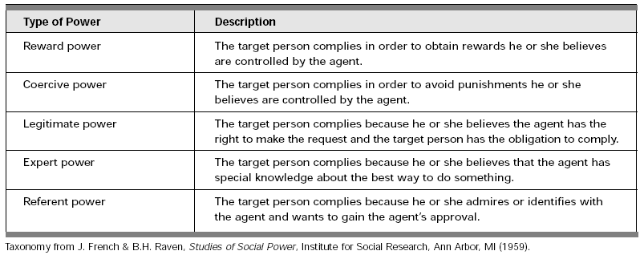
The Five Types of Power (French and Raven)
French and Raven Taxonomy as referenced in APMP 1999

Slide 20
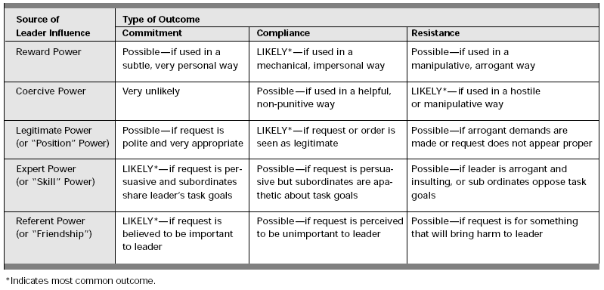
Leadership and Use of Power
Yukl 1989 as referenced in APMP Fall 1999

